Slide 2
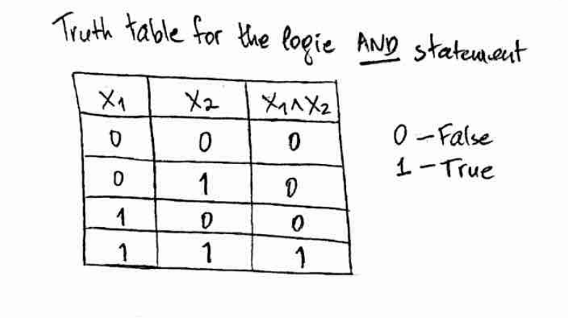
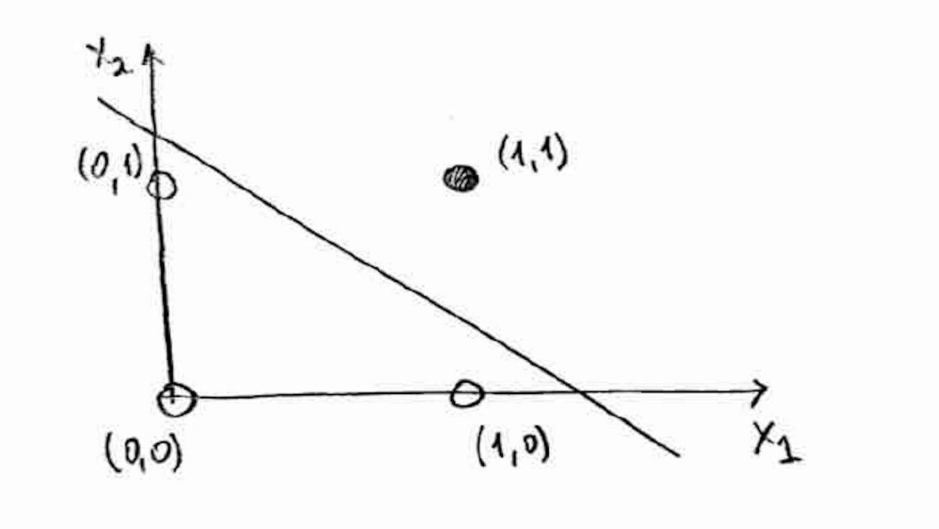
Perceptron Learning
A worked example of backpropagation | Connecting deep dots (alexander-schiendorfer.github.io)

Slide 3
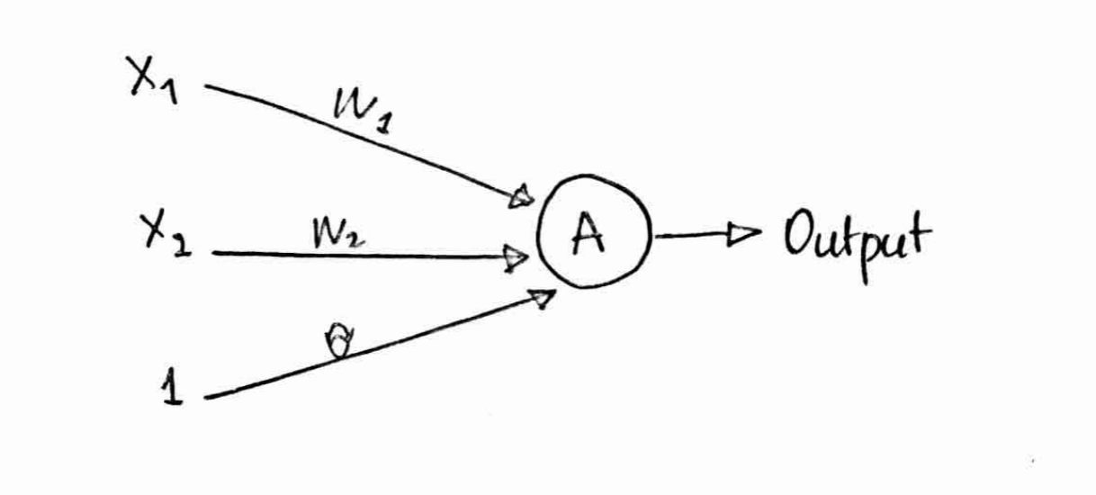
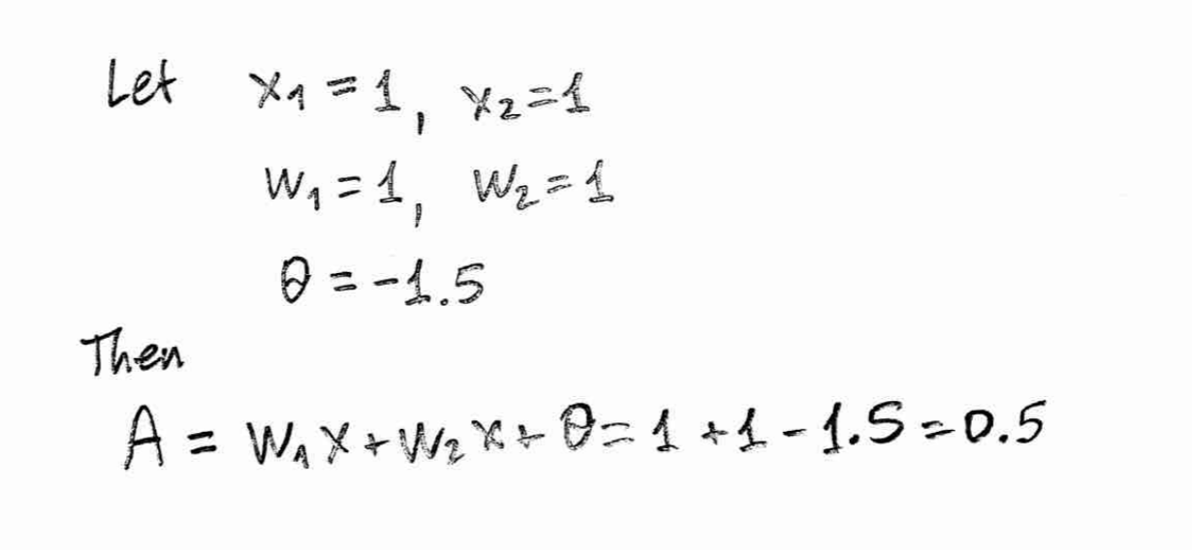
Calculations

Slide 4
X-OR problem

Slide 5
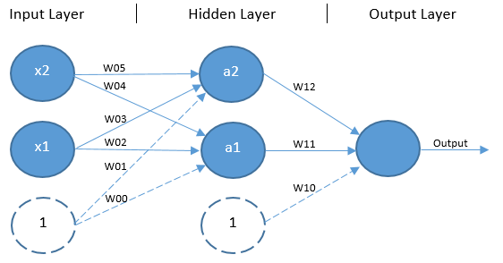

Slide 6
Layers and capabilities

Slide 7
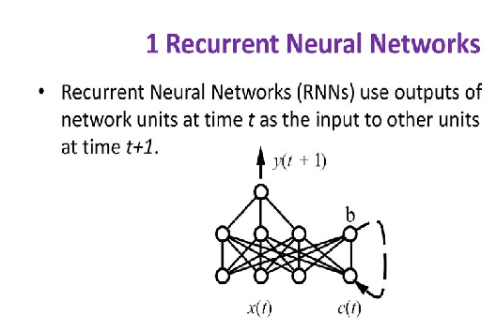
Types of Network
Fully Connected
Acyclic Network
Layered Network
Feedforward Network
Recurrent Networks
Convolution Networks

Slide 8
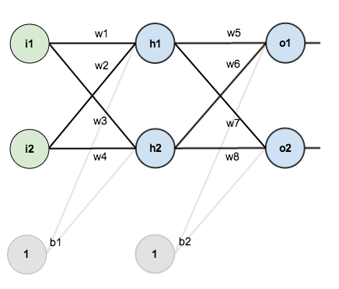
Here’s the basic structure:
Here’s the basic structure:

Slide 9
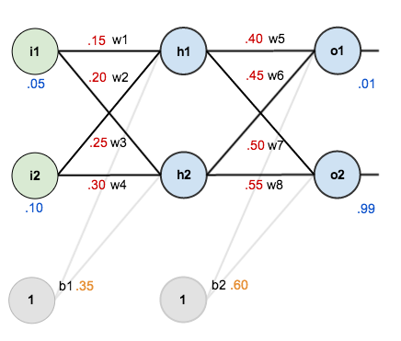
In order to have some numbers to work with, here are the initial weights, the biases, and training inputs/outputs:
given inputs 0.05 and 0.10, we want the neural network to output 0.01 and 0.99.

Slide 10
Here’s how we calculate the total net input for :
We then squash it using the logistic function to get the output of :
Carrying out the same process for h2 we get:

Slide 11
We repeat this process for the output layer neurons, using the output from the hidden layer neurons as inputs.
Here’s the output for
:
And carrying out the same process for O2 we get:

Slide 12
For example, the target output for is 0.01 but the neural network output 0.75136507, therefore its error is:
Repeating this process for (remembering that the target is 0.99) we get:
The total error for the neural network is the sum of these errors:

Slide 13

Consider . We want to know how much a change in affects the total error, aka .
is read as “the partial derivative of with respect to “. You can also say “the gradient with respect to “.
By applying the chain rule we know that:

Slide 14
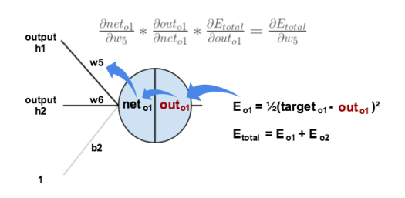
Visually, here’s what we’re doing:
We need to figure out each piece in this equation.

Slide 15
First, how much does the total error change with respect to the output?

Slide 16
The partial derivative of the logistic function is the output multiplied by 1 minus the output:

Slide 17
Finally, how much does the total net input of change with respect to W5
Putting it all together:

Slide 18
To decrease the error, we then subtract this value from the current weight (optionally multiplied by
some learning rate, eta, which we’ll set to 0.5):
We can repeat this process to get the new weights
:

